Slide 1


CS-429 Introduction to Data Science
Instructor: Mubahir Iqbal
Fall 2024

Slide 2
Lecture outline
Data Science
Data, & it’s types
File, Database, DBMS
Datafication
Big Data
Characteristics of Big Data (5V’s)
Data-Science Vs Data-Mining
Profile of Data-Scientist

Slide 3
What is Data Science?
Data science is a field that aims to find useful insights from big data.
It combines statistical mathematics, computer science, and subject knowledge to analyze, interpret, and visualize data.
This helps in solving complex problems and guiding decisions.
It is the study of:
“Understanding where information originates, what it means, and how it can be used as a valuable resource to shape business plans.”

Slide 4
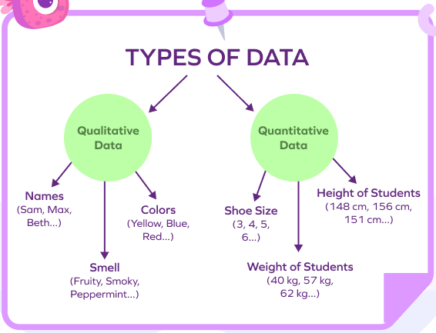
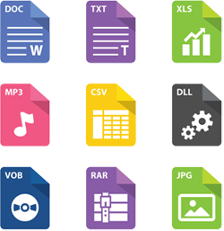
What is Data, and File?
Data: Raw facts or figures without context, which are collected and processed to provide meaningful information. Data can be in many forms, such as text, numbers, images, audio, or video.
File: A collection of related data stored together on a computer system, typically organized in a specific structure or format. Files can be text documents, images, videos, spreadsheets, etc.

Slide 5
Properties of data by Structure
1. Structured Data: Data that is organized in a clear, fixed format, typically in tables with rows and columns (like a spreadsheet)
An Excel sheet with columns for "Name," "Age," and "Salary" is structured data, as each column has a specific type and format
2. Unstructured Data: Data that does not have a specific format, making it harder to store in a structured database.
Text documents, emails, images, videos, and social media posts are unstructured

Slide 6
Properties of data by Structure
3. Semi-Structured Data: Data that isn’t as organized as structured data but has some tags or markers that make it easier to categorize
JSON or XML files are semi-structured, as they use tags (like <name>John</name>) to give some structure to the data, even though it’s not in a table format.

Slide 7
Properties of data by Type
1. Quantitative Data (Numerical Data): Data that can be measured and expressed as numbers
The height of students in centimeters (like 150 cm, 160 cm) or the number of items sold (like 30, 50)
i. Discrete Data: Numeric data with specific, countable values.
Number of children in a family (1, 2, 3, …)
ii. Continuous Data: Numeric data that can take any value within a range.
Temperature (20.5°C, 22.7°C) or height (170.2 cm, 172.5 cm)

Slide 8
Properties of data by Type
Categorical Data (Qualitative Data): Data representing categories or groups rather than numerical values.
Colours of cars (like "red," "blue," "black") or types of products in a store (like "electronics," "furniture").
i. Nominal Data: Data without any order.
Types of pets (dog, cat, bird)
ii. Ordinal Data: Data with an order but without specific numeric differences.
Rating levels (poor, fair, good, excellent)

Slide 9
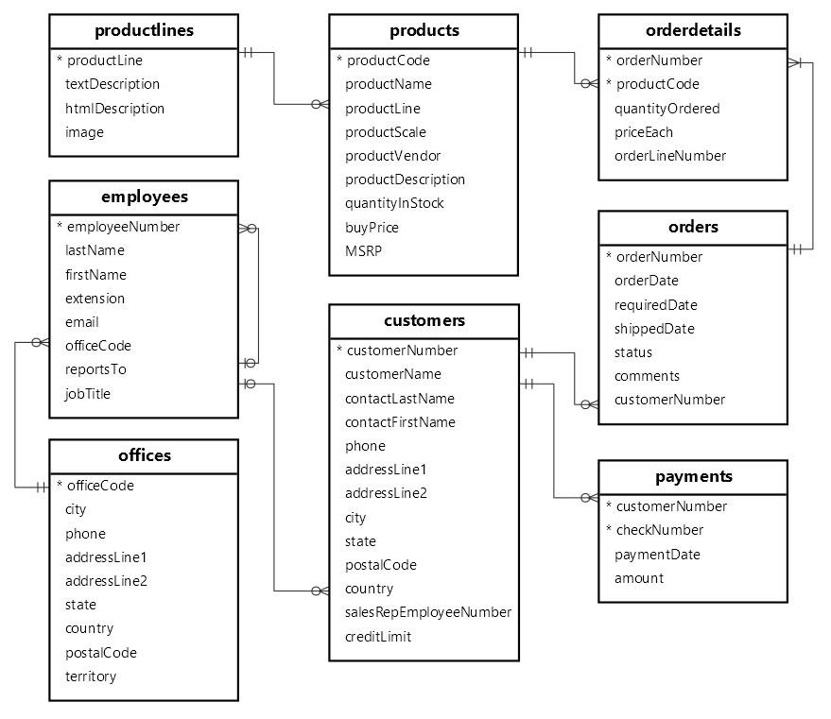
What is Database?
Database: A structured collection of data, generally organized in tables with rows (records) and columns (fields) to make data management, retrieval, and manipulation efficient.

Slide 10
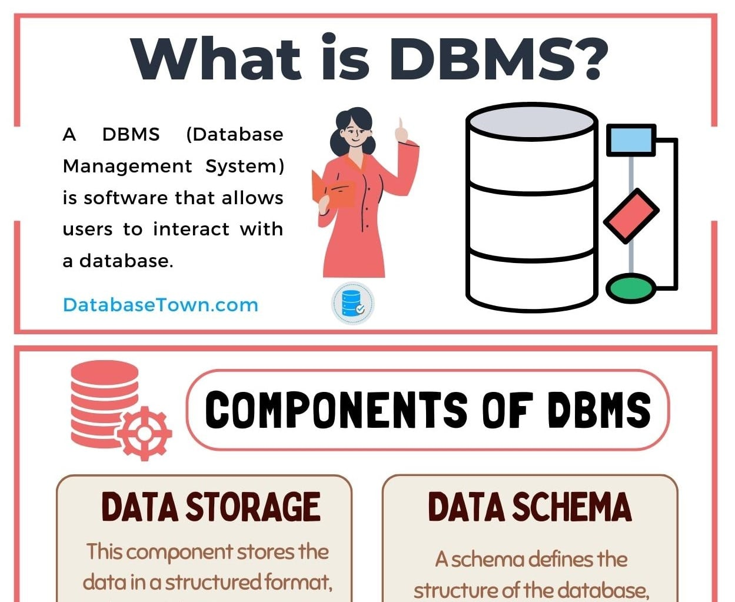
What is DBMS?
Database Management System (DBMS): A software tool that enables users to create, retrieve, update, and manage data in databases.
A DBMS provides an interface to interact with the database while ensuring data integrity, security, and consistency.
Examples: MySQL, Oracle, and Microsoft SQL Server.

Slide 11
Why Data Science and Why Now?

Slide 12
What is Datafication?
The datafication term was introduced in 2013.
A process of “Taking all aspects of life and turning them into Data” is called datafication.
This includes converting actions, emotions, and interactions into data points.
Examples:
Want to purchase a product or use a service (Rating)
Want to download a mobile app - (Reviews)
Want to Watch a movie on YouTube (Watch time/Likes, Comments)
Social media posts

Slide 13
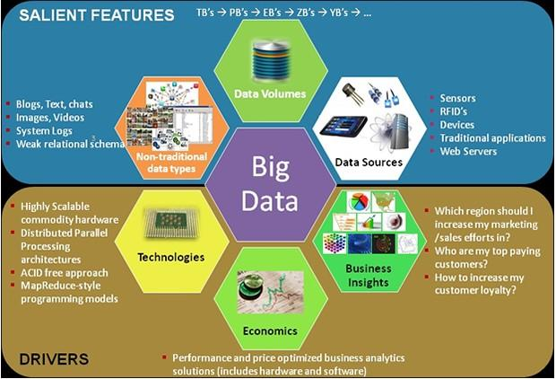
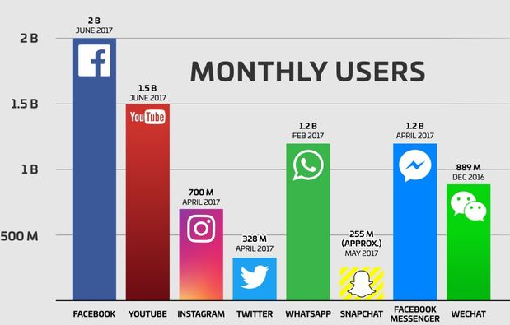
What is Big Data?
Big Data is the outcome of datafication. As more actions and objects are datafied, they contribute to Big Data.
Big Data refers to datasets that are
Large in size
Have complex relations
Fast-growing

Slide 14
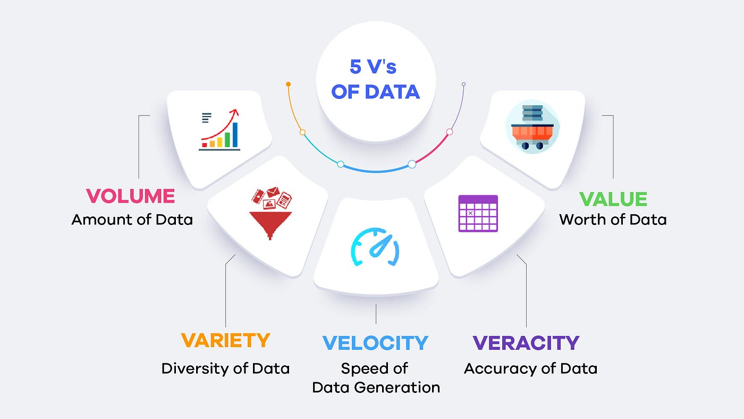
Characteristics or Properties of Big Data
Volume
Variety
Velocity
Veracity
Value

Slide 15
Big Data: Volume
This is about the amount of data. Big Data refers to huge amounts of data, usually measured in terabytes or even petabytes..
Example:
Social media platforms store
Billions of posts
Photos, and videos
Manage Comments, likes

Slide 16
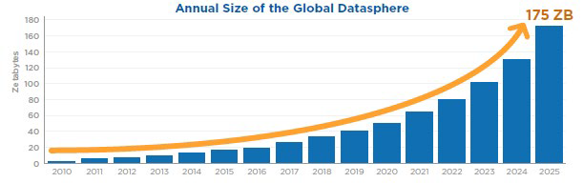
Big Data: Volume
1 ZB = 10¹² GB

Slide 17
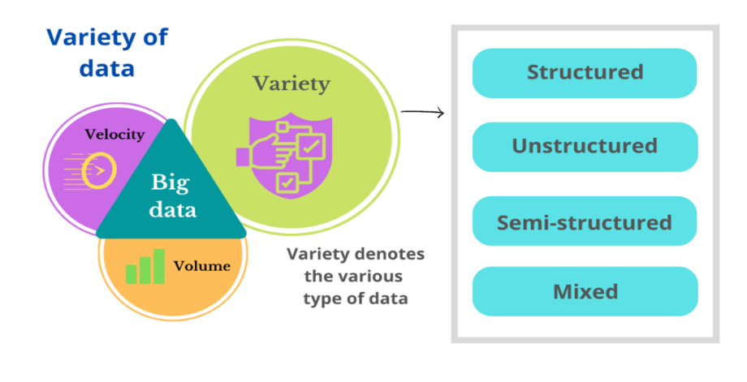
Big Data: Variety
This refers to the different types of data.
Types of data
Structured
Un-Structured
Semi-Structured
Mixed
Format of data
Numerical (Sensory data)
Text (in many different languages)
Images (Posts)
Videos (YouTube)
Audios (iTunes,

Slide 18
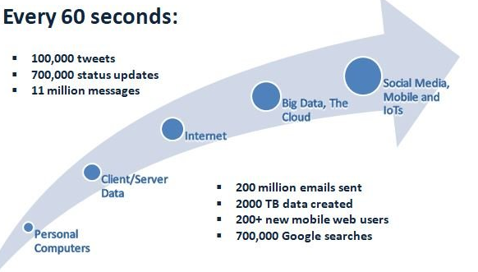
Big Data: Velocity
This is the speed at which data is created and uploaded to the internet.
Big Data often needs to be processed quickly, sometimes in real-time.

Slide 19
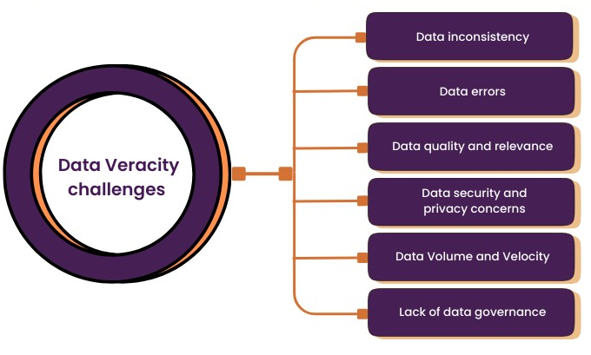
Big Data: Veracity
This is about the quality and accuracy of the data.
With Big Data, there can be errors, inconsistencies, fake, rumours, or “noise” that make it challenging to trust and make decisions.
Example: User-generated content
Duplicate posts
Fake accounts
Spam
Biased opinions

Slide 20
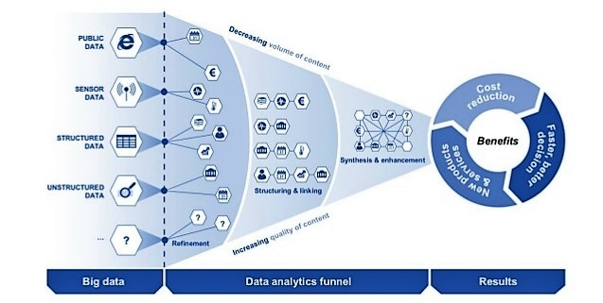
Big Data: Value
The usefulness of the data.
Big Data is only valuable if it provides insights or helps make better decisions
How it is useful
Personalized Recommendations
Targeted Ads
Traffic Navigation
Predictive Maintenance
Healthcare Diagnostics

Slide 21
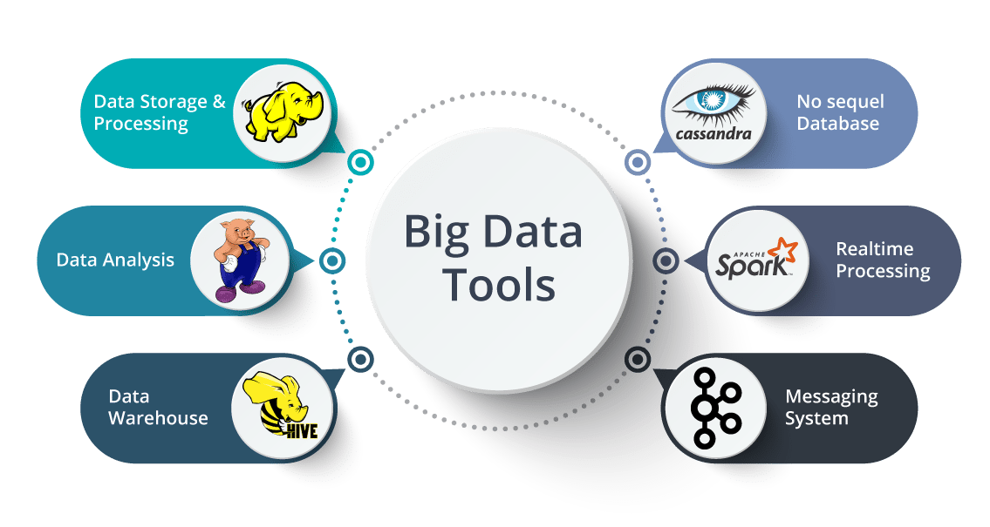
DBMS can handle Big Data?
Traditional Data Base Management Software cannot manage Big Data effectively.
Specialized tools and
Platforms are used, like
Hadoop
Spark

Slide 22
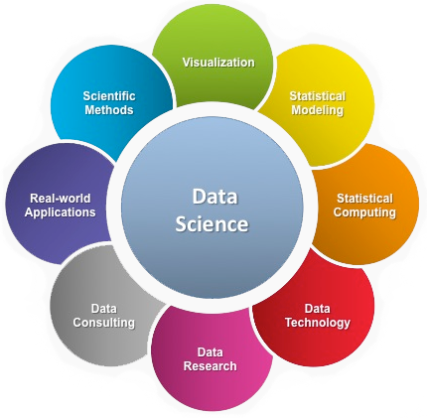
Why Data Science and Why Now?
The rapid growth of digital technologies has created a massive increase in data generation from smartphones, social media, IoT devices, and online transactions.
Advances in Computing Power
Business Demand for Data-Driven Decisions
Digital Transformation Across Industries

Slide 23
What is Data-Science?
Data science is a field that aims to find or obtain useful insights from big data.
This helps in solving complex problems and guiding decisions
Core Components of DS
Data Collection and Cleaning
Exploratory Data Analysis (EDA)
Modeling and Algorithms
Interpretation and Deployment

Slide 24
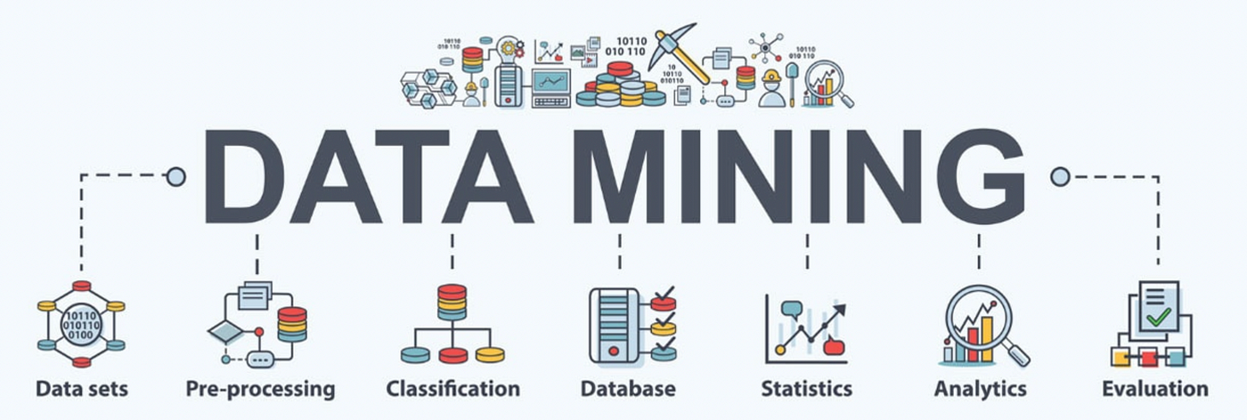
What is Data-Mining?
Data mining is the process of analyzing data to extract meaningful insights that can help make better decisions or predictions.

Slide 25
Data-Science Vs Data-Mining
Data Mining | Data Science
Data mining is a technique. | Data science is a field.
Primarily used for business purposes. | Primarily used for scientific purposes.
Data mining aims to make data more important and usable; it means extracting only useful information. | The objective of data science is to create a dominant data product.
It primarily deals with structured data. | It deals with any kind of data like structured, semi-structured, and unstructured
Data mining is a process of extracting useful information, patterns, and trends from huge databases. | Data science refers to the process of obtaining valuable insights from structured and unstructured data by using various tools and methods.

Slide 26
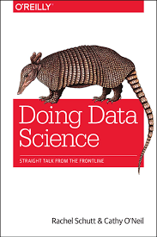
A Data Science Profile
Rachel (author of the book) asked everyone to rate their skill levels in different areas, comparing themselves to others rather than using an absolute scale.
The fields are:
Computer science
Math
Statistics
Machine learning
Domain expertise
Communication and presentation skills
Data visualization

Slide 27
The Data Scientist Skills
A typical data-scientist skills should be

Slide 28
The Data Scientists Team Skills
There should be alignment between the data science team profile and the profile of the data problems they try to solve

Slide 29
Relationships: Four Categories and five skills set
Columns: Fields
Rows: Skills

Slide 30
Honesty is not the best policy in life

